Slide 1

Problem Solvation and further optimization
Yongrun Huang Tianyi Wu
Week 3

Slide 2
The Problems we faced last meeting
Define stress（Ground-truth）
Real classification of individual stress states：either the study protocol conditions as labels, or the answers to the self-report questionnaires
‘label’: ID of the respective study protocol condition, sampled at 700 Hz. The following IDs are provided: 0 = not defined / transient, 1 = baseline, 2 = stress, 3 = amusement, 4 = meditation, 5/6/7 = should be ignored in this dataset.
Data leakage（Dataset splitting）
K-fold Cross Validation

Slide 3
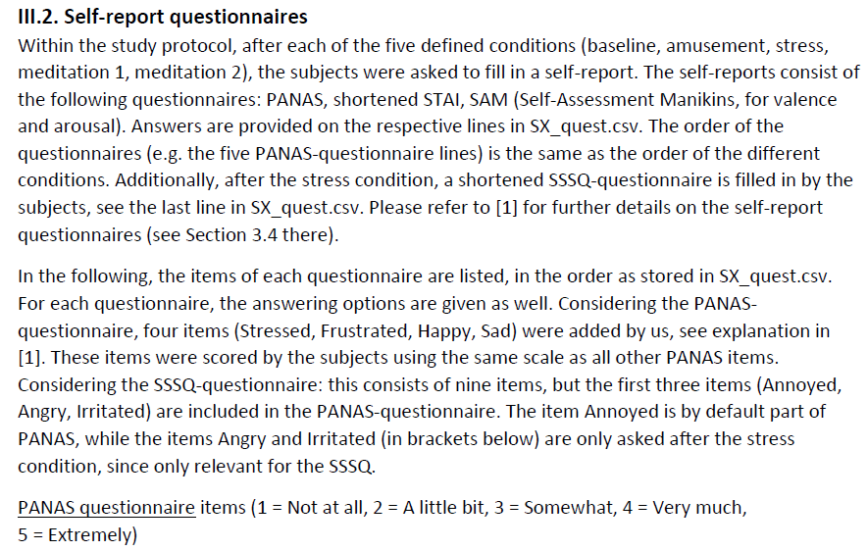

Slide 4
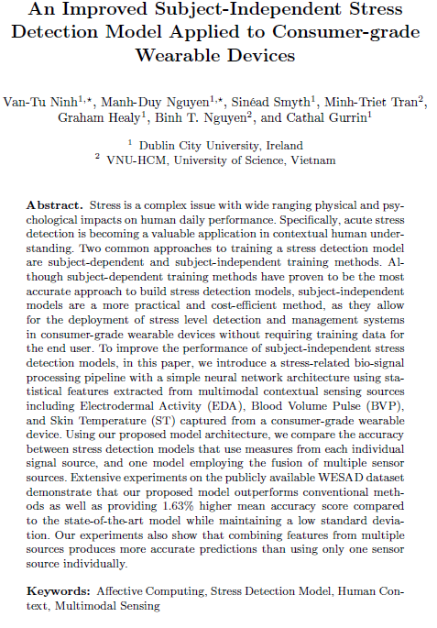
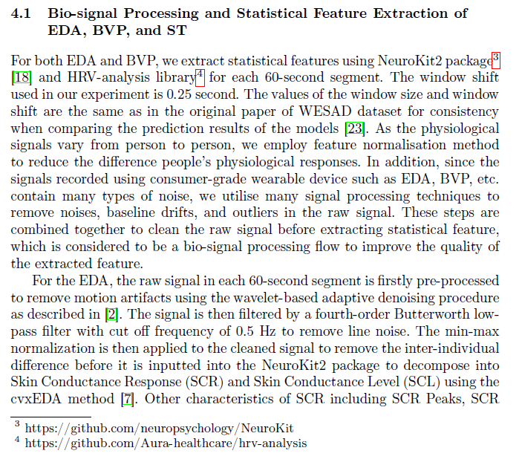

Slide 5
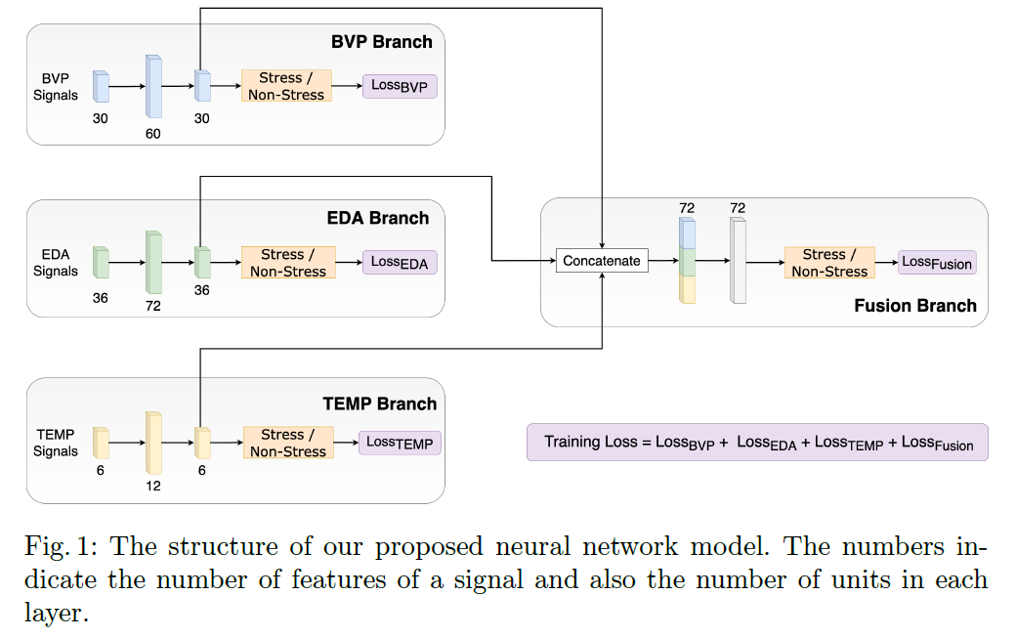

Slide 6

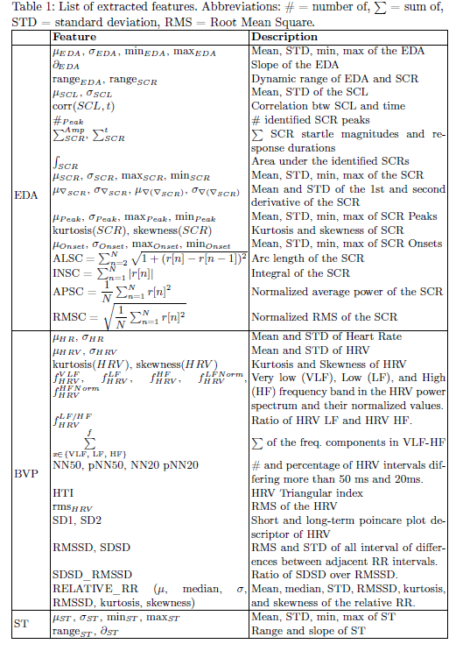
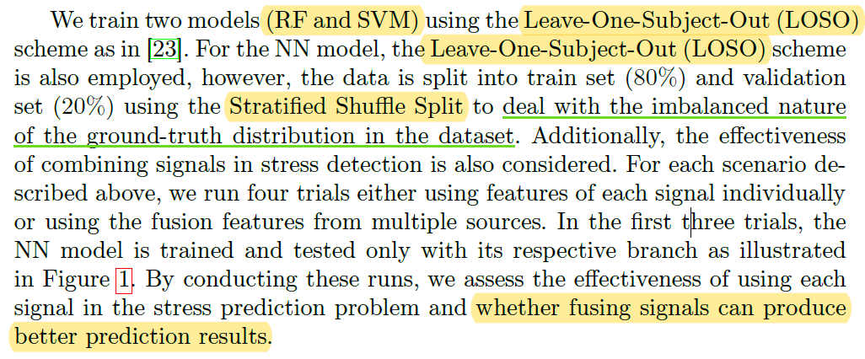
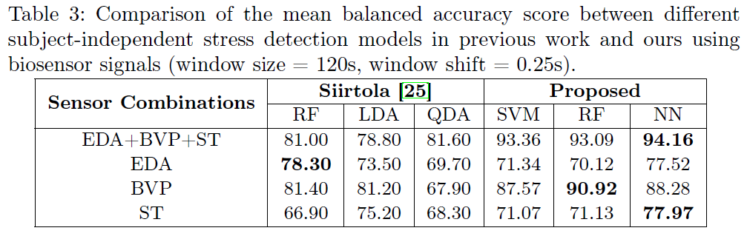

Slide 7
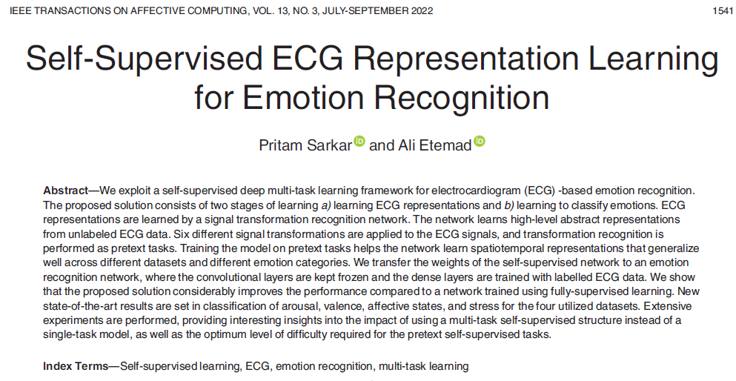
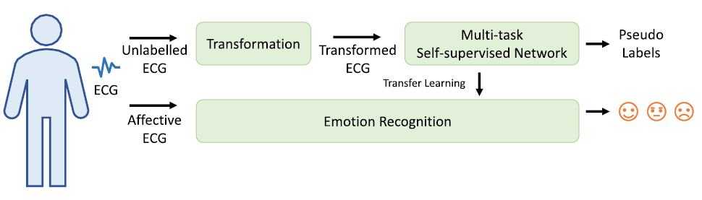

Slide 8
